Slide 1

On the Grand Challenge
Emanuele “Manu” Viola
Northeastern University
2025 04 22
Notes:
welcome
one possible view of the world is that it looks like a pyramid at the top of the pyramid is the P versus NP problem and at the bottom of the pyramid there are many extremely important but somewhat specialized problems that one needs to solve slowly and patiently in order to climb the pyramid and get to the top.
These problems range from circuit complexity to communication complexity to matrix rigidity to problems concerning polynomials.
Now I want to propose a different viewin which the pyramid is upside down and rather than there being many problems that lead to P versus NP there is only a few problems and actually these problems get fewer and fewer while we reach the tip of the pyramid which is now at the bottomand a good question is which problem is right here what is a problem which is really fundamental and stands in the way of progress to much of the rest of the pyramid what can we put there?
So let us consider various problems that have been studied in order to make progress on P versus NP
one problem is that of proving circuit lower boundsand for this talk you can think of proving say quasi-polynomial circuit lover bounds even for depth 3 circuits i'm not going to be precise on every problem but some of them will be defined formally soon another problem is Valiant's challenge of constructing rigid matrices these are just matrices which have say constant hamming distance from matrices which have low rank another outstanding problem is through approving correlation bounds of polynomials meaning exhibiting functions which cannot be computed well on average by low degree polynomialsyet another challenge is that concerning multi-party communication complexity specifically in the number on forehead model okay and here a long-standing challenge is to proving lower bounds even worse case lower bounds when the number of parties is more than logarithmicnow of these problems is there one which is more fundamental than than the other in the sense that progress on the problem stands in the way of progress for the other problems as well well let's see some connectionsfirst if you want to make progress on circuit lower bounds except for some quite narrow settings or parameters you're going to have to make progress on correlation bounds for polynomials so i put an arrow here from a to b ifmaking progress on a requires making progress on b okay and this arrow is not hard to prove um say by min maxwhat about matrix rigidity well it may be a little bit less well known that if you want to make progress on matrix rigidity then you also have to make progress on correlation bounds for polynomialswhat about multiparty communication complexity well it may be even less well known that even this requires progress on correlation bounds for polynomials okay and you can find references and proofs of all these things in my papersso what do we do in this work in this work we prove we put one more error okay we consider some recently made fourier conjectures and we showed that even these recent fourier conjectureswould require first making progress on correlation bounds for polynomialsso based on all this i want to propose this specific view in which the pyramid is upside down and the problem which is at the tip of the pyramid which touches the ground is there proving correlation bounds for low degree polynomials let me now be specific and define this problemso the challenge of correlation bounds is to find an explicit function f from n bits to one bit and some distribution x such that for every polynomial p of degree d the correlation between f and p is small and the correlation here is just defined as the probability over an input drawn from x that f of x is equal to p of x and small means at most half plus epsilon note that you can always find the polynomial p which agrees with f with probability at least half just because f is boolean and here we are saying you cannot do much better than that you can only do it most half plus epsilon back in the 80s Razborov and Smolensky Smolensky showed that for the function majority and for the uniform distribution x you can prove a bound that epsilon is at most order of d over square root n okay that is under the uniform distribution every polynomial of degree d okay agrees with the majority function on at most in half plus order of d over root n fraction of the inputs okay so um this bound on epsilon is vanishing as long as d is less than root n so it can handle fairly large degrees but the bound on epsilon is only at best one over root n and obtaining a smaller epsilon proving a smaller bound on epsilon for any explicit function remains open for any degree which is larger than log n okay for tiny degrees you can do something different iterated because she's worth but for degrees larger than log n this bound remains the best known and improving this bound stands in the way of progress for each problem on the previous slide so what about these fourier conjectures so recently a new paradigm has been developed for constructing pseudorandom generators this paradigm is called the polarizing random walks and it can construct pseudorandom generators from fourier bounds from bounds on the fourier spectrum of functionsso a specific goal of this paradigm is to obtain better pseudorandom generators for low degree polynomials the state of the arts about generators for low degree polynomials has not changed since the works from more than 10 years ago and is limited to polynomials of degree at most log n so in an effort to obtain generators for polynomials of degree even larger than log n with this paradigm several fourier conjectures have been proposed have been made so one conjecture is that the sum of the fourier coefficients of size 2 of any polynomial of degree d should be at the most order of dsquare and another conjecture is that if you sum the fourier coefficients of a degree d polynomial of size k then you obtain 2 raised to little o of dkit has been shown in these works that if you can prove these things for low degree polynomials then you would indeed have new pseudorandom generators that improve on the zero of the art using the polarizing random works paradigmso in this work we showed that these conjectures and in fact even weaker conjectures would imply correlation bounds which already beat the Razborov Smolensky boundsokay so proving these conjectures on the fourier spectrum implies better correlation bounds that we haveand these correlation bounds which are implied by our connections are for function which are related to majority so for example the function which given input of n bits takes the sum of the product of every pair of bits and checks if this sum is at least half and if i think of the bits as being plus 1 or minus 1 i can just write bigger than 0. this is the function that that you get from the first conjecture here if you look at this other conjecture here where you sum the coefficients of size k you will get the function in which you take products of size kmotivated by this conjecture sorry motivated by this connectionin this work we also prove several new correlation bounds these correlation bounds aim to but don't resolve the fourier conjectureswe specifically prove new correlation bounds for the function which was on the previous slide which is related to majority however it seems more natural to just start with majority and our starting point is the observation that in fact the correlation with majority is still openso we prove several new results about majority the first thing that we prove is that Smolensky's bound of epsilon at most order of d over root n for majority is in fact tight under the uniform distribution okay there are polynomials which achieve this correlation under the uniform distribution so we cannot improve the bounds under the uniform but we could do so under some other distribution andin this direction we show we exhibit polynomials which achieveomega d squared over n correlation meaning they agree with the function half plus omega d square over nunder every distribution so for every distribution there is a polynomial which has this correlationokay this bound here is weaker than Smolensky's is quadratic in Smolensky's bound but on the positive side holds under every distribution and we conjecture that this bound is tight okay that there is there exists a distribution with respect to which you cannot improve this bound and in the paper we have a specific candidate for what would be a hard distribution proving this conjecture seems to be a nice directionto better understand majority andwe are able to prove it in the specific but not completely trivial case of linear polynomials uh in which case we also improve Smolensky okay so we show that for linear polynomials of degree one uh the correlation is not the order of 1 over square root of n but it's in fact order of 1 over n and even proving this for degree 2 seems interesting so a suitable extension and strengthening of these results would disprove the fourier conjecturesthat is all and thank you very much

Slide 2
3

Slide 3
2

Slide 4
1

Slide 5
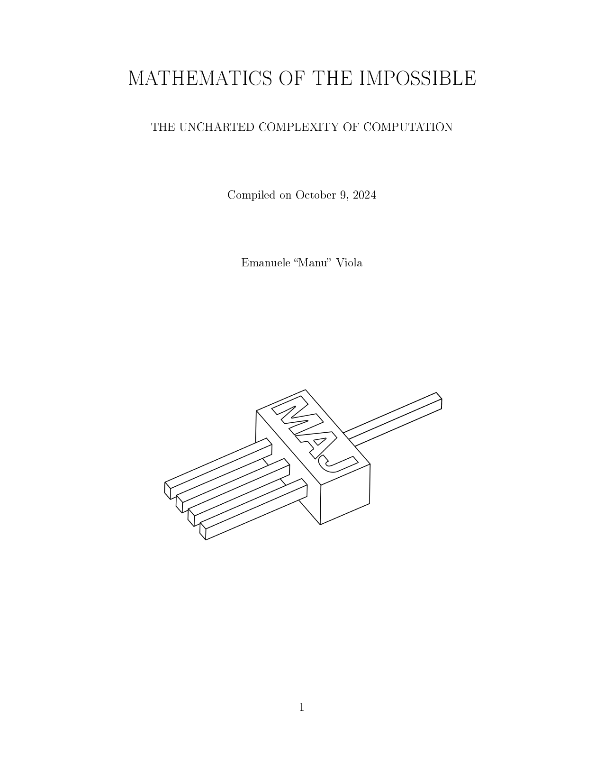
Book ad Mathematics of the impossible Draft on my homepage

Slide 6
Outline
The grand challenge, some historical highlights
Correlation bounds against polynomials
Why do known bounds stop “right before” major results?
A case study: data structures and circuits

Slide 7
The Grand Challenge (1930 – present)
Prove impossibility results
in computational models,
a.k.a. “lower bounds”
P vs NP is young, prominent special case
Sometimes we say P vs NP to mean the grand challenge

Slide 8

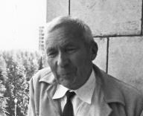
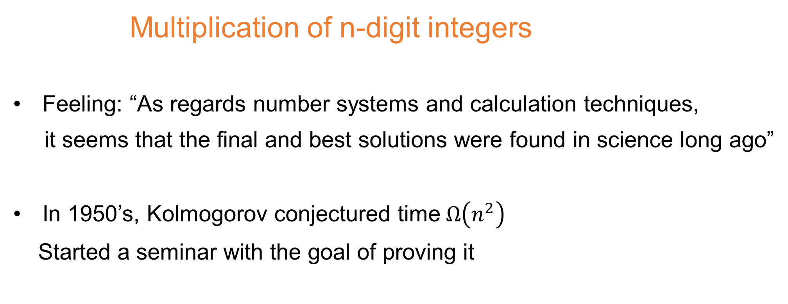
Multiplication of n-digit integers
Feeling: “As regards number systems and calculation techniques,
it seems that the final and best solutions were found in science long ago”
In 1950’s, Kolmogorov conjectured time$Ω\left(n^{2}\right)$
Started a seminar with the goal of proving it

Slide 9

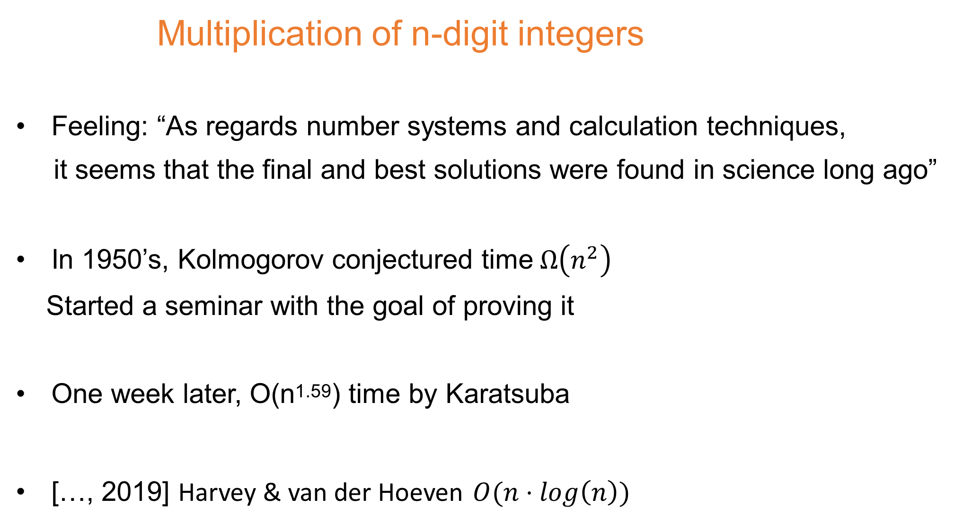
Multiplication of n-digit integers
Feeling: “As regards number systems and calculation techniques,
it seems that the final and best solutions were found in science long ago”
In 1950’s, Kolmogorov conjectured time$Ω\left(n^{2}\right)$
Started a seminar with the goal of proving it
One week later, O(n^{1.59}) time by Karatsuba
[…, 2019] Harvey & van der Hoeven $O(n⋅log\left(n\right))$

Slide 10


Multiplication of nxn matrices
1968 Strassen working to prove $Ω\left(n^{3}\right)$

Slide 11
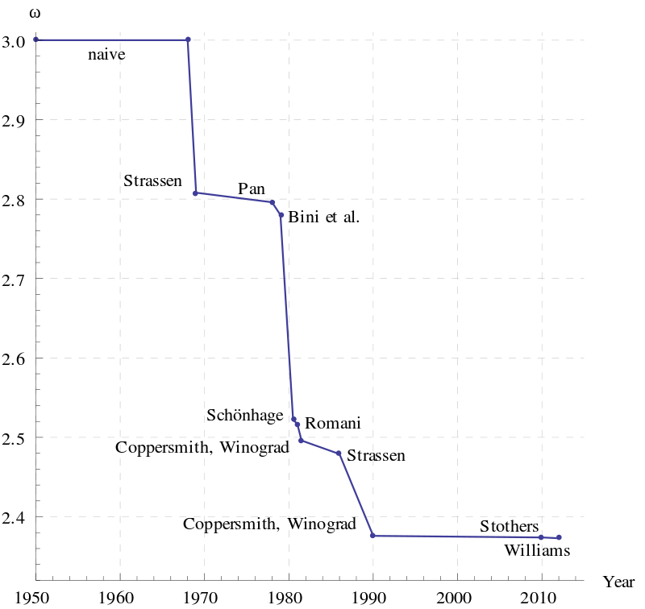

Multiplication of nxn matrices
1968 Strassen working to prove $Ω\left(n^{3}\right)$
1969: Volker Strassen.
Gaussian elimination is not optimal.
Numer. Math., 13:354–356, 1969.
$O(n^{2.81})$ algorithm

Slide 12
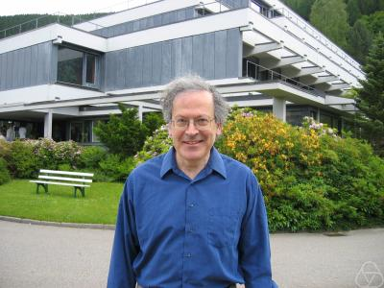
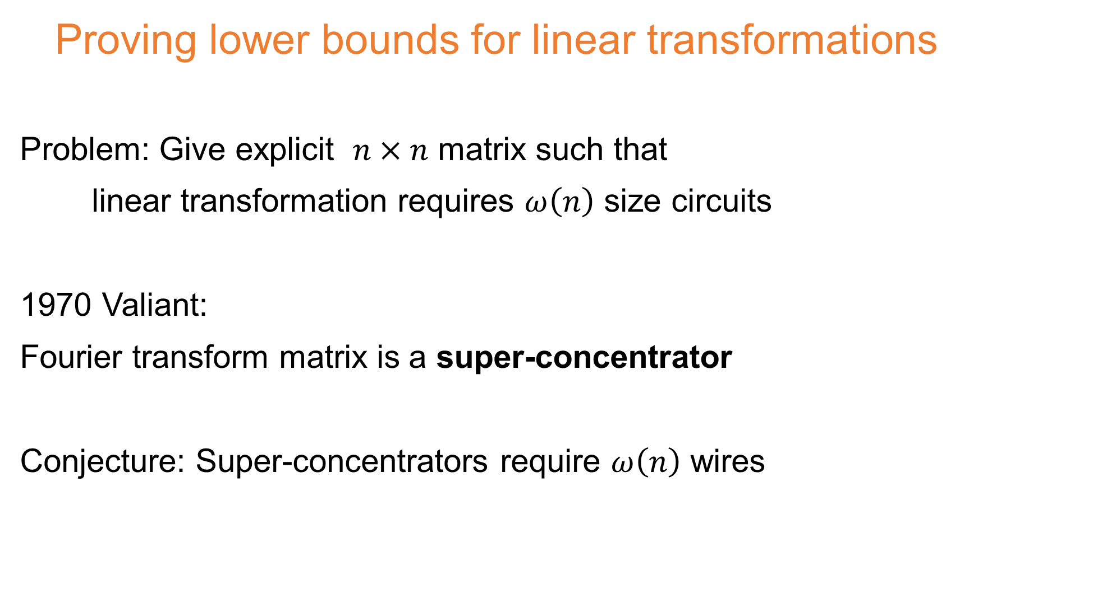
Proving lower bounds for linear transformations
Problem: Give explicit $n×n$ matrix such that
linear transformation requires $ω\left(n\right)$ size circuits
1970 Valiant:
Fourier transform matrix is a super-concentrator
Conjecture: Super-concentrators require $ω\left(n\right)$ wires

Slide 13
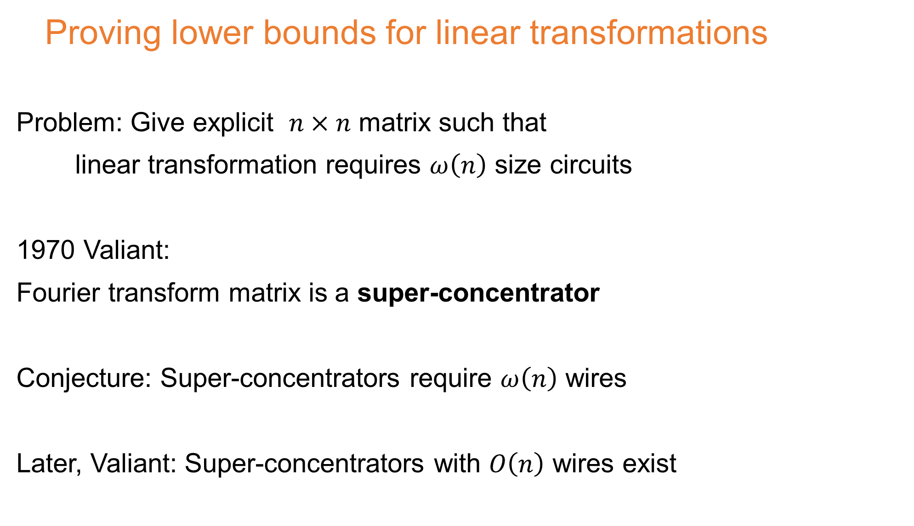
Proving lower bounds for linear transformations
Problem: Give explicit $n×n$ matrix such that
linear transformation requires $ω\left(n\right)$ size circuits
1970 Valiant:
Fourier transform matrix is a super-concentrator
Conjecture: Super-concentrators require $ω\left(n\right)$ wires
Later, Valiant: Super-concentrators with $O\left(n\right)$ wires exist

Slide 14
Space-bounded
Finite-state automata read input left to right
Theorem: Can’t recognize palindromes
Let’s allow them to read bits multiple times
Conjecture 1983 [Borodin, Dolev, Fich, Paul] Can’t compute majority efficiently
1
q₀
q₁
1
0
0

Slide 15

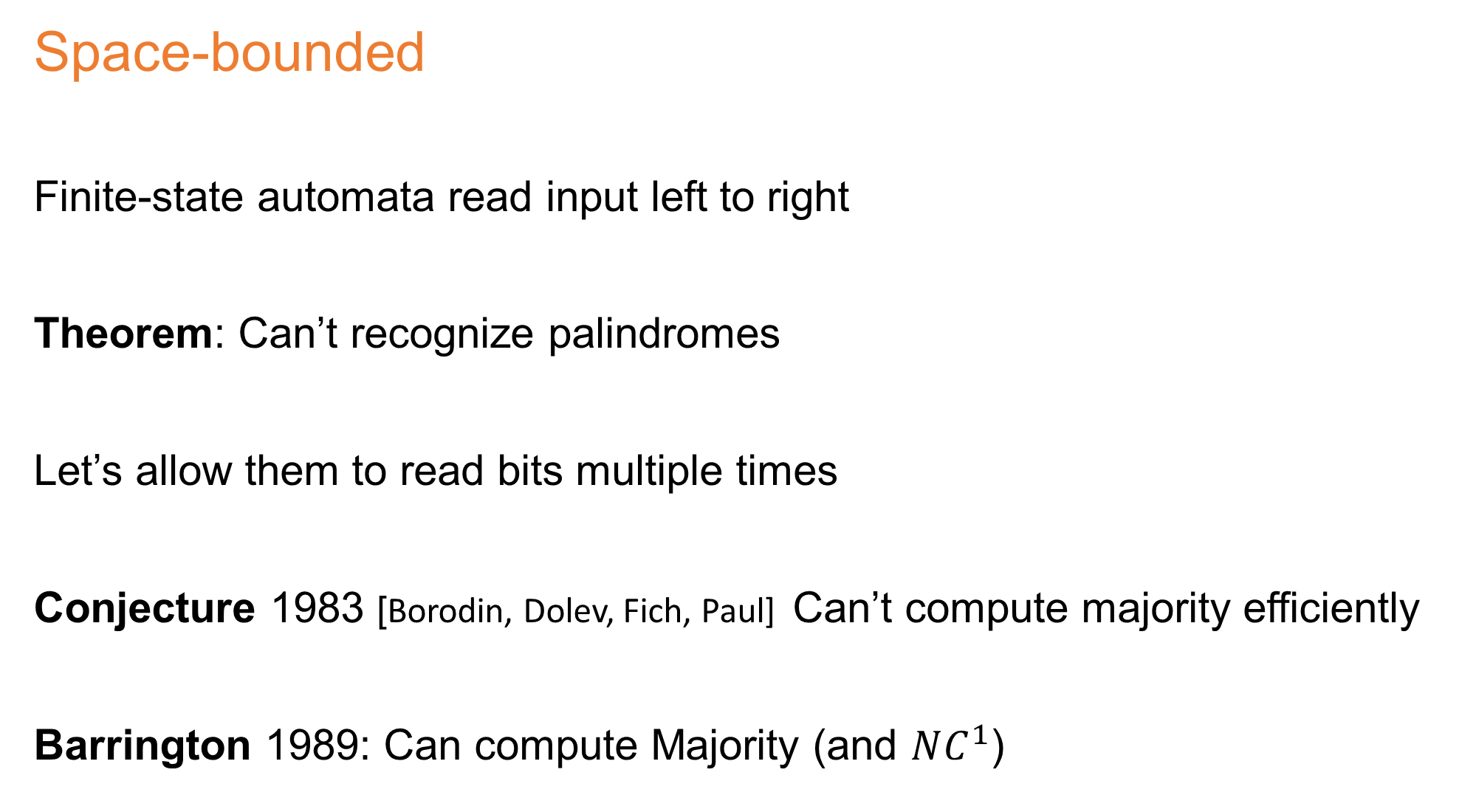
Space-bounded
Finite-state automata read input left to right
Theorem: Can’t recognize palindromes
Let’s allow them to read bits multiple times
Conjecture 1983 [Borodin, Dolev, Fich, Paul] Can’t compute majority efficiently
Barrington 1989: Can compute Majority (and $NC^{1}$)
1
q₀
q₁
1
0
0

Slide 16
Boolean circuits
Universal hash functions [Carter Wegman 79]
Conjecture 1990 [Mansour Nisan Tiwari]
Require super-linear size circuits

Slide 17
Boolean circuits
Universal hash functions [Carter Wegman 79]
Conjecture 1990 [Mansour Nisan Tiwari]
Require super-linear size circuits
Theorem 2008 [Ishai Kushilevitz Ostrovsky Sahai]
Linear-size suffices

Slide 18
… many more such examples (see my book)
Next: A “bottleneck” for making progress

Slide 19
Outline
The grand challenge, some historical highlights
Correlation bounds against polynomials
Why do known bounds stop “right before” major results?
A case study: data structures and circuits

Slide 20
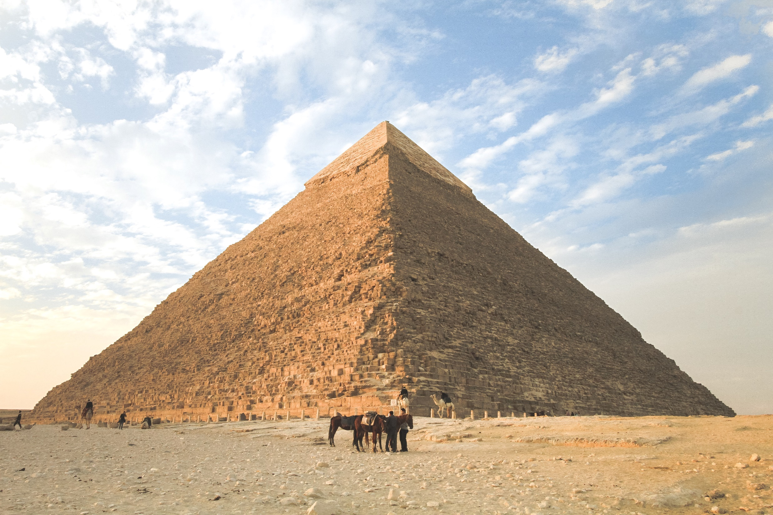
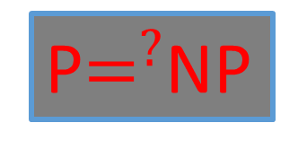
One possible view
P$=^{?}$NP

Slide 21
One possible view
P$=^{?}$NP
Circuits

Slide 22
One possible view
P$=^{?}$NP
Circuits
Communication

Slide 23
One possible view
P$=^{?}$NP
Rigidity
Circuits
Communication

Slide 24
One possible view
P$=^{?}$NP
Rigidity
Circuits
Communication
Polynomials

Slide 25

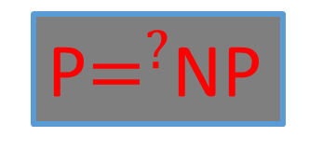
A different view
P$=^{?}$NP

Slide 26
A different view
P$=^{?}$NP

Slide 27
A different view
P$=^{?}$NP

Slide 28
A different view
P$=^{?}$NP

Slide 29
A different view
P$=^{?}$NP
What goes here?

Slide 30
Frontier of P vs. NP
Circuit lower bounds

Slide 31
Frontier of P vs. NP
Circuit lower bounds
Matrix rigidity

Slide 32
Frontier of P vs. NP
Circuit lower bounds
Matrix rigidity
Correlation bounds for polynomials

Slide 33
Frontier of P vs. NP
Circuit lower bounds
Matrix rigidity
Multi-party
Communication complexity
Correlation bounds for polynomials

Slide 34
Frontier of P vs. NP
Circuit lower bounds
Matrix rigidity
Multi-party
Communication complexity
Correlation bounds for polynomials
A B means progress on A requires progress on B

Slide 35
Frontier of P vs. NP
Circuit lower bounds
Matrix rigidity
Multi-party
Communication complexity
Correlation bounds for polynomials
A B means progress on A requires progress on B

Slide 36
Frontier of P vs. NP
Circuit lower bounds
Matrix rigidity
Multi-party
Communication complexity
Correlation bounds for polynomials
A B means progress on A requires progress on B

Slide 37
Frontier of P vs. NP
Circuit lower bounds
Matrix rigidity
Multi-party
Communication complexity
Correlation bounds for polynomials
Recent
Fourier conjectures

Slide 38
My view
P$=^{?}$NP
Circuits
Rigidity
Communication
Polynomials

Slide 39
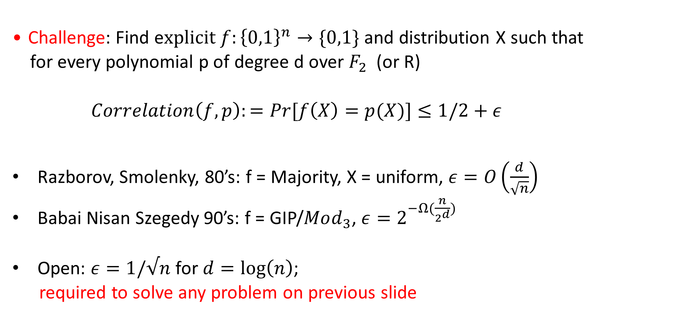
Correlation bounds for polynomials Survey on my homepage 2008, updated 2022
Challenge: Find e$xplicit f:{\left\{0,1\right\}}^{n}→\{0,1\}$ and distribution X such that
for every polynomial p of degree d over $F_{2}$ (or R)
$\underset{}{Correlation\left(f,p\right):=Pr}{[f\left(X\right)}=p(X)]≤1/2+ε$
Razborov, Smolenky, 80’s: f = Majority, X = uniform, $ε=O\left(\frac{d}{\sqrt{n}}\right)$
Babai Nisan Szegedy 90’s: f = GIP/$Mod_{3}$, $ε=2^{−Ω(\frac{n}{2^{d}}) }$
Open: $ε=1/√n$ for $d=\log\left(n\right)$;
required to solve any problem on previous slide

Slide 40
Next on polynomials
Some recent results on correlation and pseudorandom generators

Slide 41
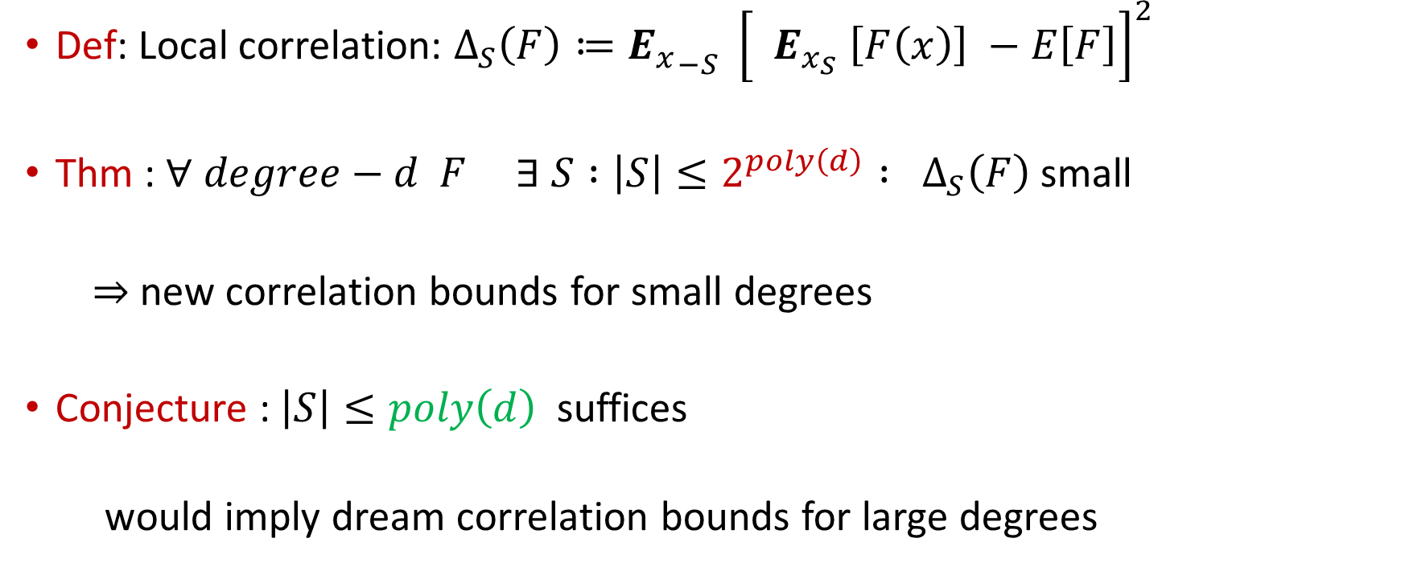
[Chattopadhyay Hatami Hosseini Lovett Zuckerman ] STOC 2020
Def: Local correlation: $Δ_{S}\left(F\right)≔{E_{x}}_{−S} {\left[ E_{x_{S}} \left[F\left(x\right)\right] −E\left[F\right]\right]}^{2}$
Thm : $∀ degree−d F ∃ S :\left|S\right|≤2^{poly\left(d\right)} : Δ_{S}\left(F\right)$small
$⇒$new correlation bounds for small degrees
Conjecture : $\left|S\right|≤poly\left(d\right)$suffices
would imply dream correlation bounds for large degrees

Slide 42
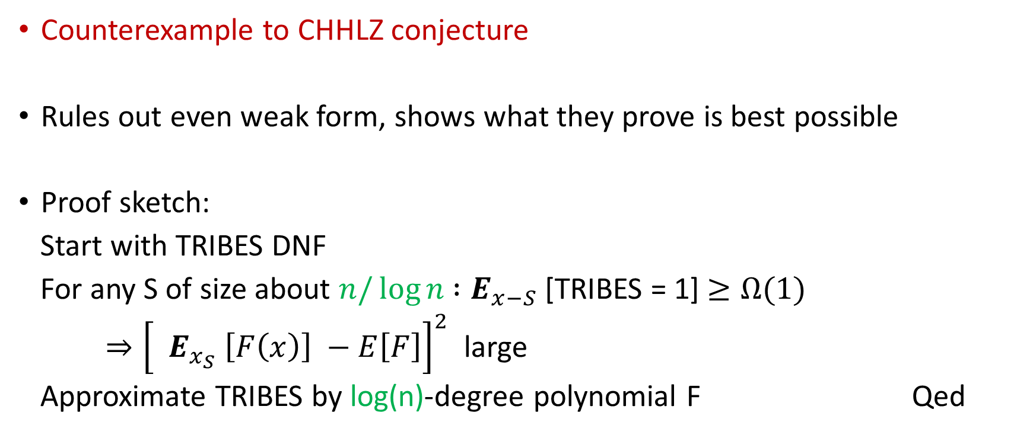
[Ivanov Pavlovic V]
Counterexample to CHHLZ conjecture
Rules out even weak form, shows what they prove is best possible
Proof sketch:
Start with TRIBES DNF
For any S of size about $n/\log{n}{ :E}_{x−S}$[TRIBES = 1] $≥Ω(1)$
$⇒{\left[ E_{x_{S}} \left[F\left(x\right)\right] −E\left[F\right]\right]}^{2}$ large
Approximate TRIBES by log(n)-degree polynomial F Qed

Slide 43
[Ivanov Pavlovic V]
Conjecture: Symmetric polynomials maximize correlation with mod 3;
would imply dream correlation bounds
Prove the conjecture for degree 2 by “slowly opening directions”
Prove the conjecture for special classes of degree 3

Slide 44
Pseudorandom generators
Explicit, low-entropy distributions that “look random” to polynomials
Equivalent to correlation bounds for small error
Case of large error remains unclear
State-of-the-art [Bogdanov V 2007, Lovett, V]:
To fool degree-d polynomials sum d independent generators for degree 1
Can analyze up to d < 0.01 log n. Beyond that is unknown…??

Slide 45
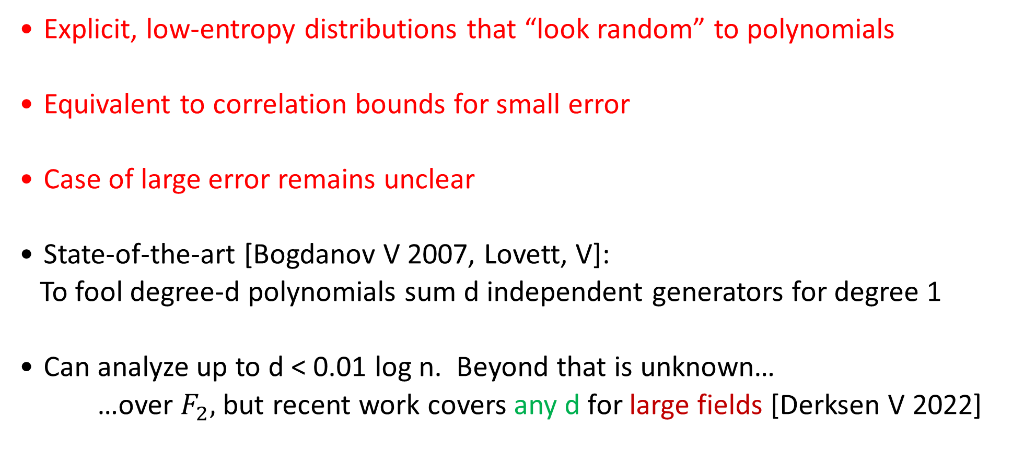
Pseudorandom generators
Explicit, low-entropy distributions that “look random” to polynomials
Equivalent to correlation bounds for small error
Case of large error remains unclear
State-of-the-art [Bogdanov V 2007, Lovett, V]:
To fool degree-d polynomials sum d independent generators for degree 1
Can analyze up to d < 0.01 log n. Beyond that is unknown…
…over $F_{2},$ but recent work covers any d for large fields [Derksen V 2022]

Slide 46
Outline
The grand challenge, some historical highlights
Correlation bounds against polynomials
Why do known bounds stop “right before” major results?
A case study: data structures and circuits

Slide 47
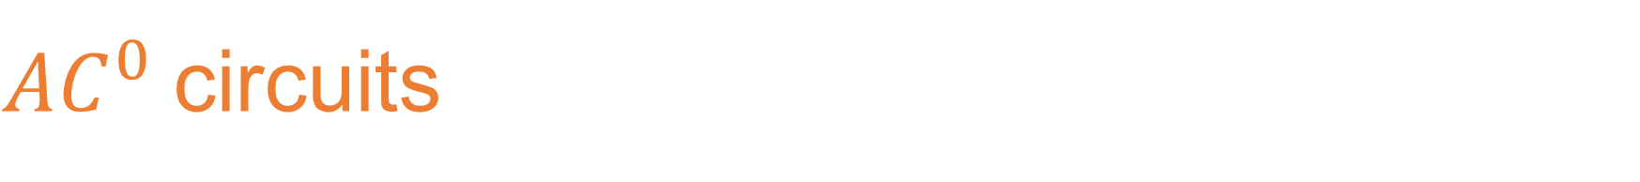
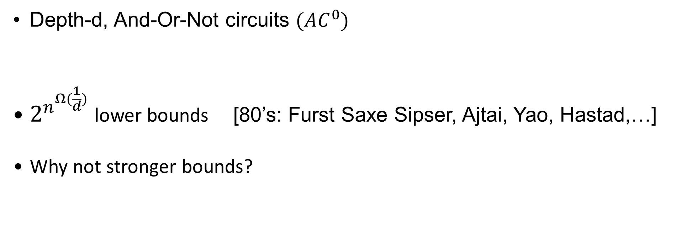
$AC^{0}$circuits
Input x
¬
V
V
V
¬
Depth
d=3
Depth-d, And-Or-Not circuits $(AC^{0})$
$2^{n^{Ω(\frac{1}{d})}}$lower bounds [80’s: Furst Saxe Sipser, Ajtai, Yao, Hastad,…]
Why not stronger bounds?
/\
/\
/\
V

Slide 48
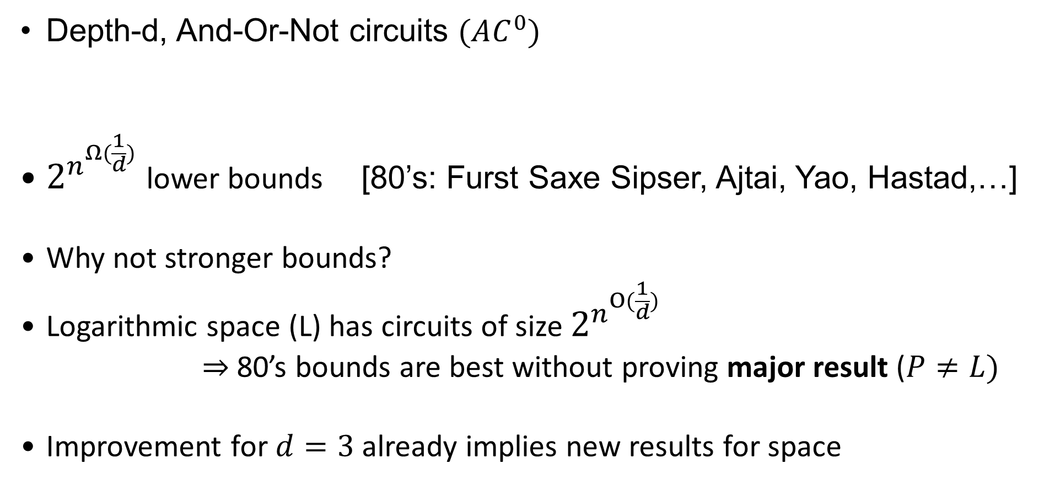
$AC^{0}$circuits
Input x
¬
V
V
V
¬
Depth
d=3
Depth-d, And-Or-Not circuits $(AC^{0})$
$2^{n^{Ω(\frac{1}{d})}}$lower bounds [80’s: Furst Saxe Sipser, Ajtai, Yao, Hastad,…]
Why not stronger bounds?
Logarithmic space (L) has circuits of size $2^{n^{O(\frac{1}{d})}}$
$⇒$80’s bounds are best without proving major result ($P≠L)$
Improvement for $d=3$ already implies new results for space
/\
/\
/\
V

Slide 49
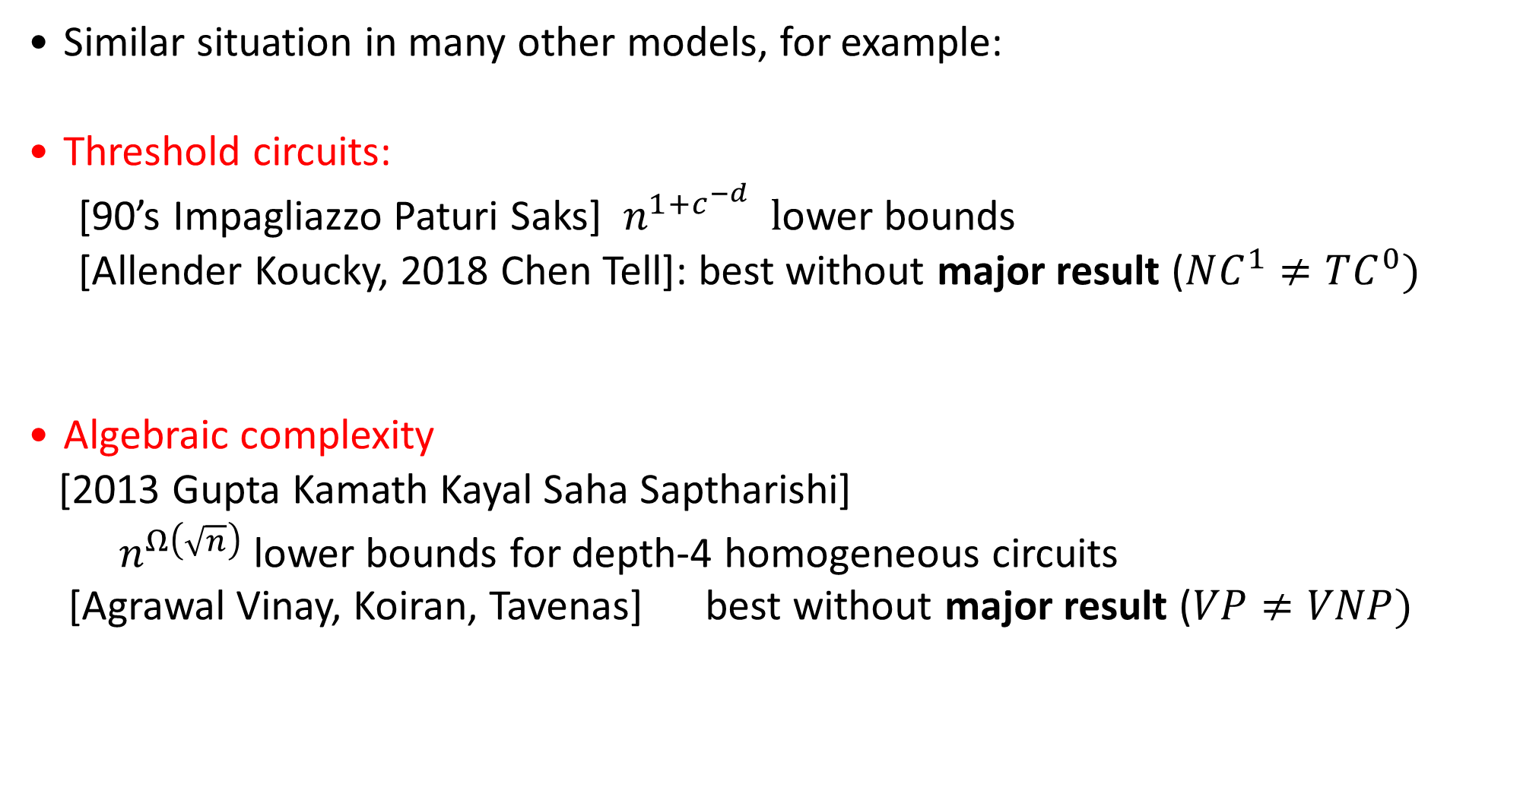
Similar phenomenon
Similar situation in many other models, for example:
Threshold circuits:
[90’s Impagliazzo Paturi Saks] $n^{1+c^{−d}} l$ower bounds
[Allender Koucky, 2018 Chen Tell]: best without major result ($NC^{1}≠TC^{0})$
Algebraic complexity
[2013 Gupta Kamath Kayal Saha Saptharishi]
$n^{Ω\left(\sqrt{n}\right)}$ lower bounds for depth-4 homogeneous circuits [Agrawal Vinay, Koiran, Tavenas] best without major result ($VP≠VNP)$

Slide 50
Why do current bounds stop “just before” proving major results?

Slide 51
Why do current bounds stop “just before” proving major results?
No reason, it’s coincidence I would find this “strange” because same bounds proved with seemingly different techniques

Slide 52
Why do current bounds stop “just before” proving major results?
No reason, it’s coincidence I would find this “strange” because same bounds proved with seemingly different techniques
Current techniques are X, for major results need Y

Slide 53
Why do current bounds stop “just before” proving major results?
No reason, it’s coincidence I would find this “strange” because same bounds proved with seemingly different techniques
Current techniques are X, for major results need Y
Major results are false

Slide 54
Outline
The grand challenge, some historical highlights
Correlation bounds against polynomials
Why do known bounds stop “right before” major results?
A case study: data structures and circuits

Slide 55
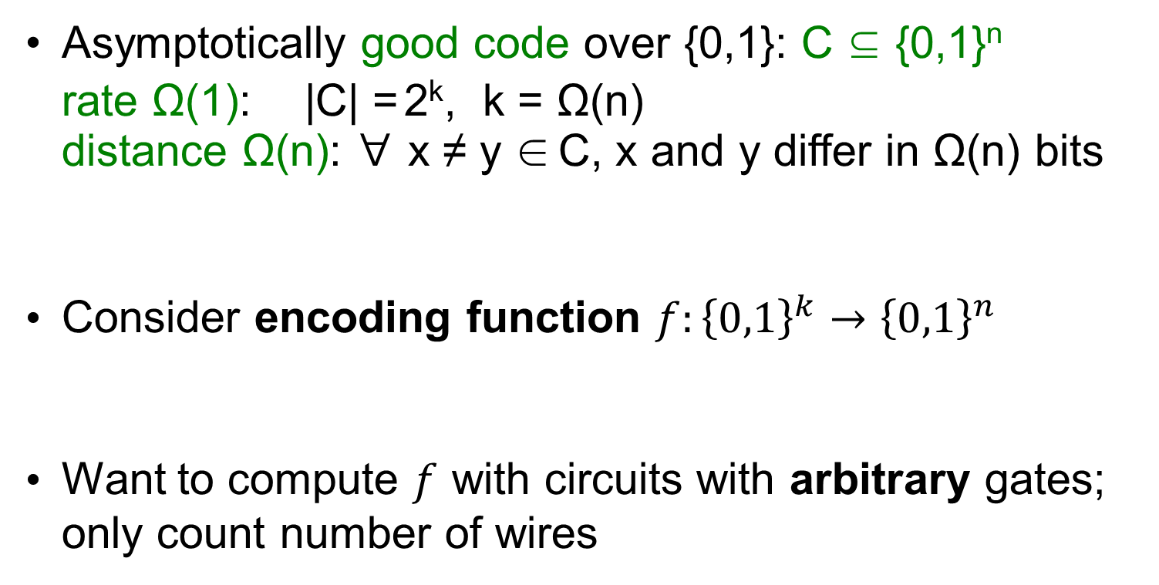
Complexity of error-correction encoding
Asymptotically good code over {0,1}: C ⊆ {0,1}^{n}
rate Ω(1): |C| = 2^{k}, k = Ω(n)
distance Ω(n): ∀ x ≠ y ∈ C, x and y differ in Ω(n) bits
Consider encoding function $f:{\left\{0,1\right\}}^{k}→{\left\{0,1\right\}}^{n}$
Want to compute $f$ with circuits with arbitrary gates; only count number of wires
k-bit message
Encoding
n-bit codeword

Slide 56
Previous work
Message
Depth 1 Wires Θ(n²)
+ + + + + + + +
n-bit Codeword
Unbounded fan-in
Depth O(log n) Wires Θ(n)
Fan-in 2
[Gelfand Dobrushin Pinsker 73] [Spielman 95]
Message
+ + + + +
+ + + + + +
+ + + + + +
.........
n-bit Codeword
Message
+ + + + + + + +
+ + + + + + + +
Question: How many wires for depth 2?
n-bit Codeword

Slide 57
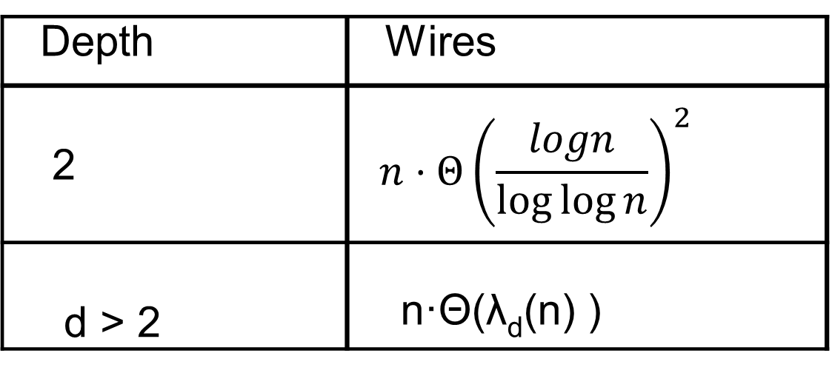
[Gál Hansen Koucký Pudlák V 2012]
Depth | Wires
2 | $${n⋅Θ\left(\frac{logn}{\log{\log{n}}}\right)}^{2}$$
d > 2 | n·Θ(λ_{d}(n) )
Message
+ + + + + + + +
+ + + + + + + +
n-bit Codeword
λ inverse Ackermann: λ₃(n)=log log n, λ₄(n)=log*n, ...
Best-known bound for linear function in NP

Slide 58
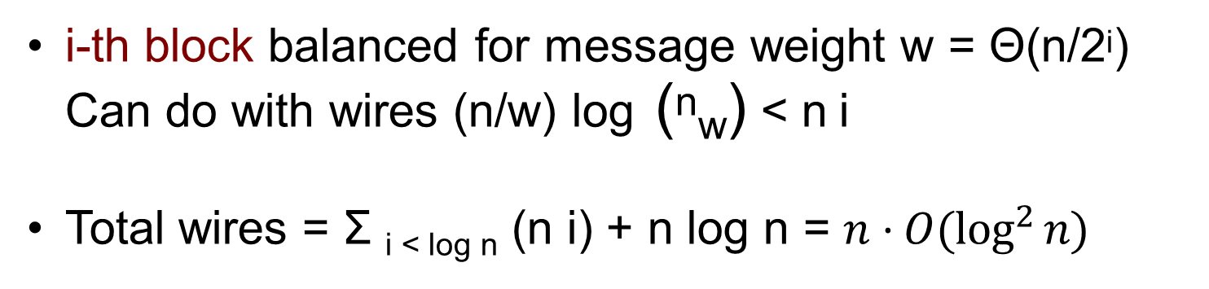
Probabilistic construction
message
Layer of log n blocks
∀ message ∃ balanced block
Output bit:
XOR one random bit per block
...
+
+ + + + ++
+ + + + + + +
n-bit codeword
i-th block balanced for message weight w = Θ(n/2^{i}) Can do with wires (n/w) log (^{n}_{w}) < n i
Total wires = Σ _{i < log n} (n i) + n log n = $n⋅O(\log^{2}{n)}$

Slide 59
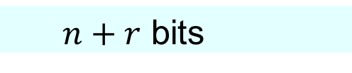
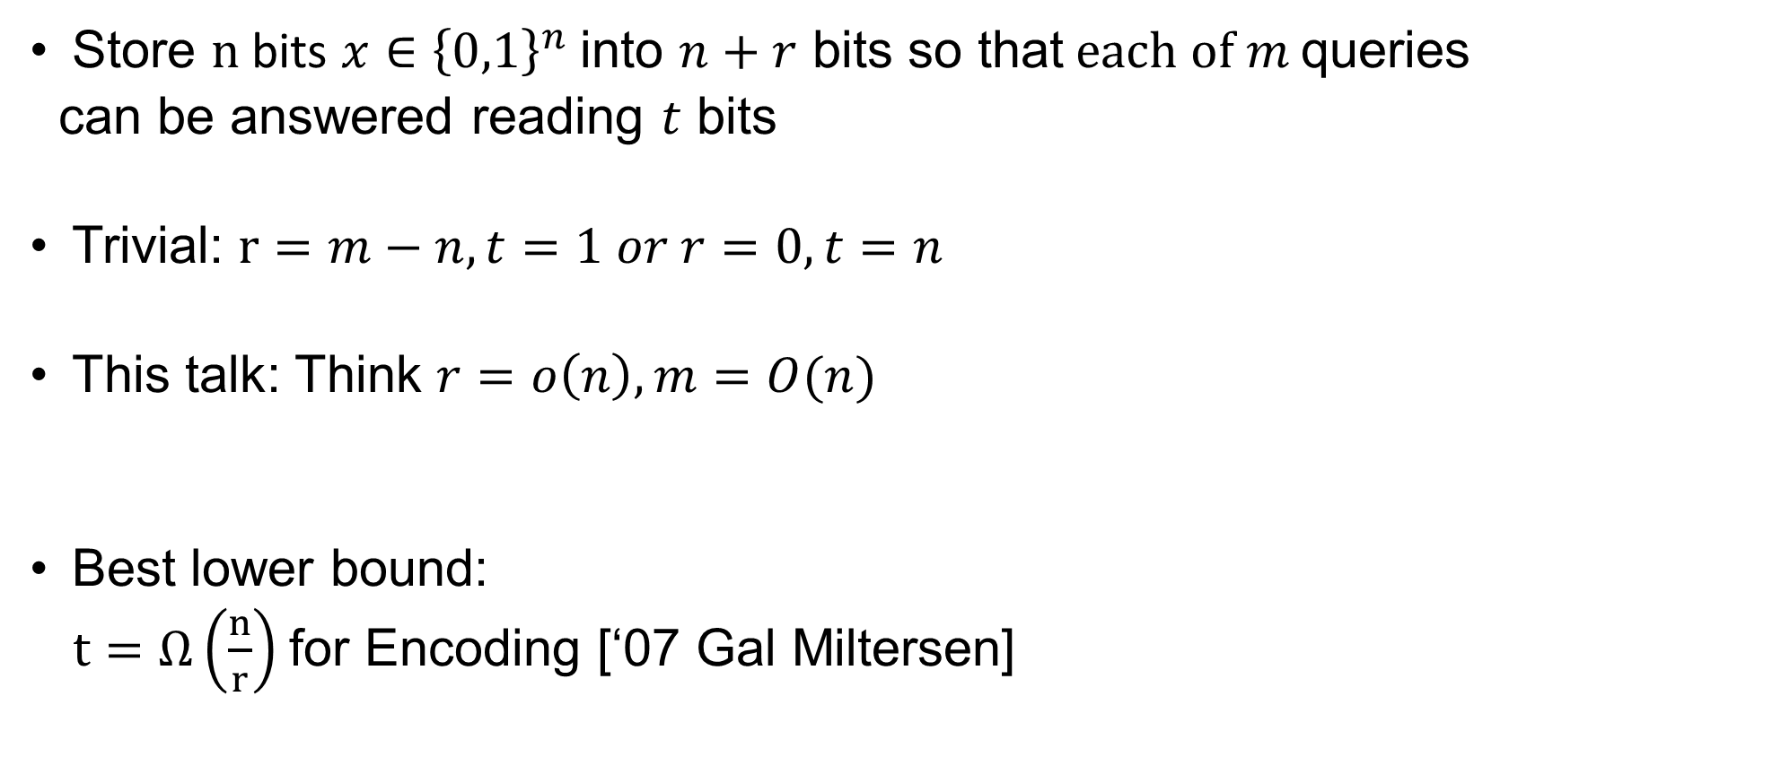
Static data structures
Store $n$ bits $x∈{\left\{0,1\right\}}^{n}$into $n+r$ bits so that$each of m$queries
can be answered reading $t$ bits
Trivial: $r=m−n,t=1 or r=0,t=n$
This talk: Think $r=o\left(n\right),m=O(n)$
Best lower bound:
$t=Ω\left(\frac{n}{r}\right)$for Encoding [‘07 Gal Miltersen]
n-bit data
Arbitrary
map A
$n+r$ bits
t
m-bit output (queries)

Slide 60
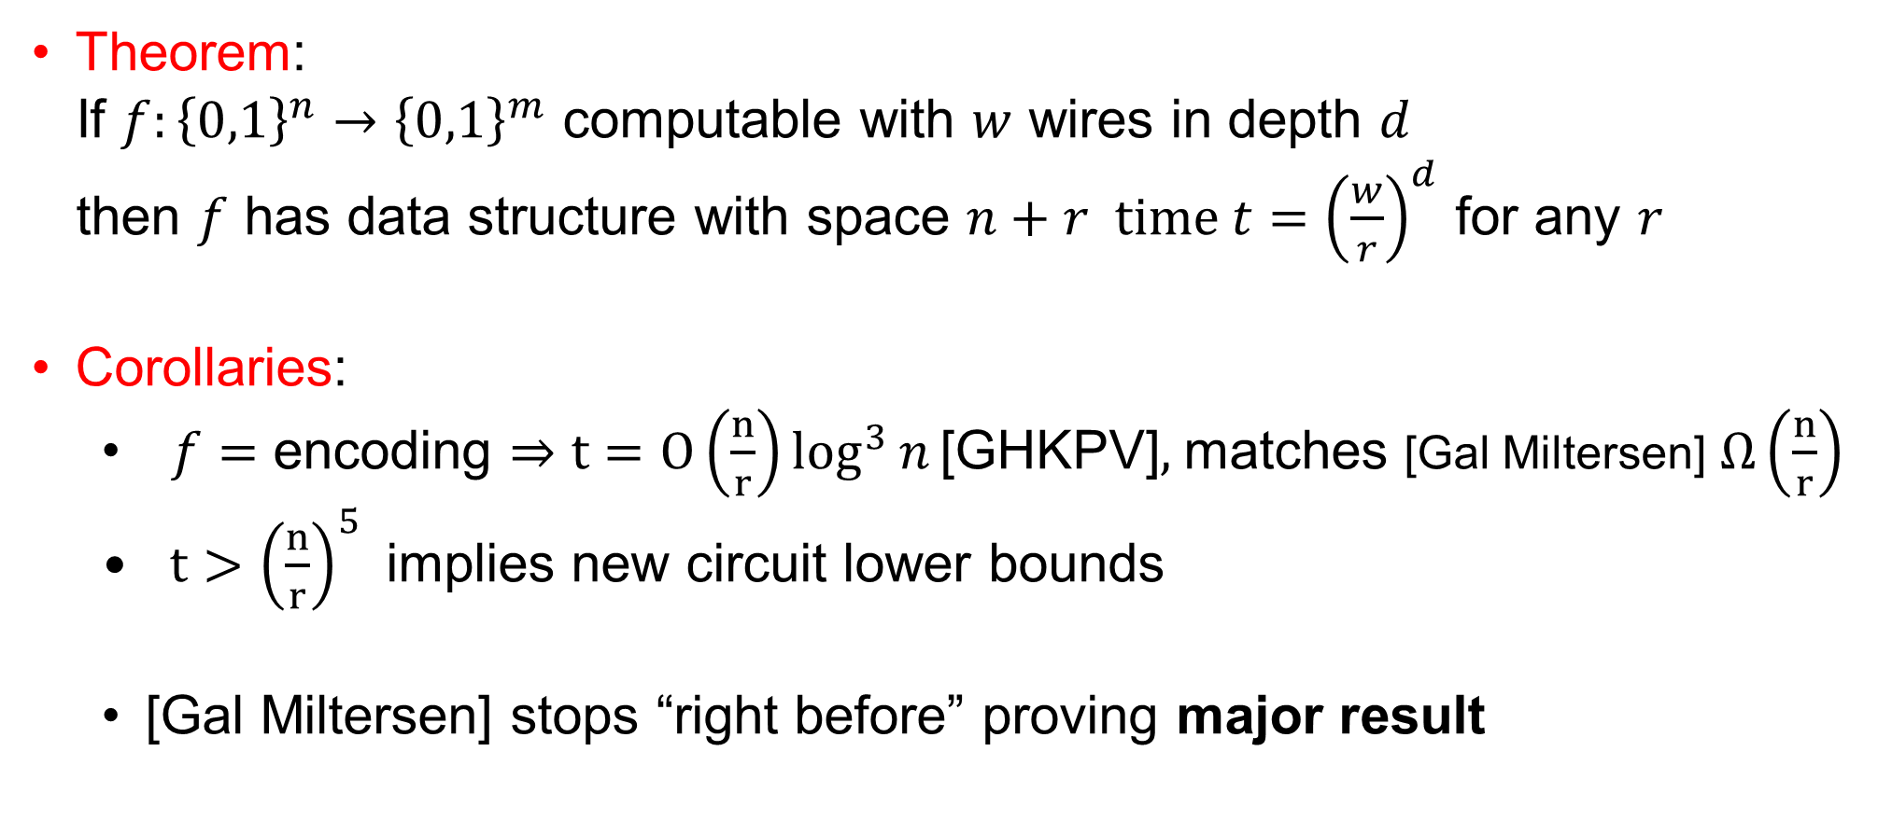
From circuits to data structures [V 2018]
Theorem:
If $f:{\left\{0,1\right\}}^{n}→{\left\{0,1\right\}}^{m}$ computable with $w$ wires in depth $d$
then $f$ has data structure with space $n+r time {t=\left(\frac{w}{r}\right)}^{d}$ for any $r$
Corollaries:
$f=$ encoding $⇒$ $t=O\left(\frac{n}{r}\right)\log^{3}{n}\text{[}\text{GHKPV}\text{]},$matches [Gal Miltersen] $Ω\left(\frac{n}{r}\right)$
$t>{\left(\frac{n}{r}\right)}^{5}$implies new circuit lower bounds
[Gal Miltersen] stops “right before” proving major result

Slide 61
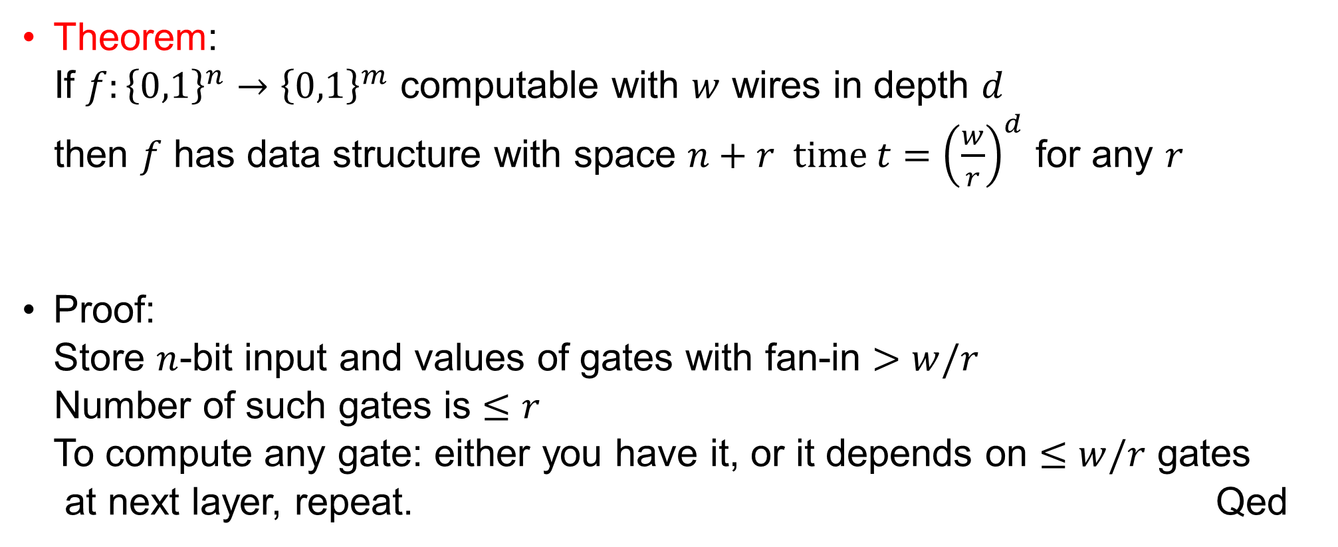
From circuits to data structures [V 2018]
Theorem:
If $f:{\left\{0,1\right\}}^{n}→{\left\{0,1\right\}}^{m}$ computable with $w$ wires in depth $d$
then $f$ has data structure with space $n+r time {t=\left(\frac{w}{r}\right)}^{d}$ for any $r$
Proof:
Store $n$-bit input and values of gates with fan-in $>w/r$
Number of such gates is $≤r$
To compute any gate: either you have it, or it depends on $≤w/r$ gates
at next layer, repeat. Qed

Slide 62

Open
Data structures lower bounds for $r=n^{2}, m=r^{3}$imply anything?

Slide 63

Thanks!

