Slide 1
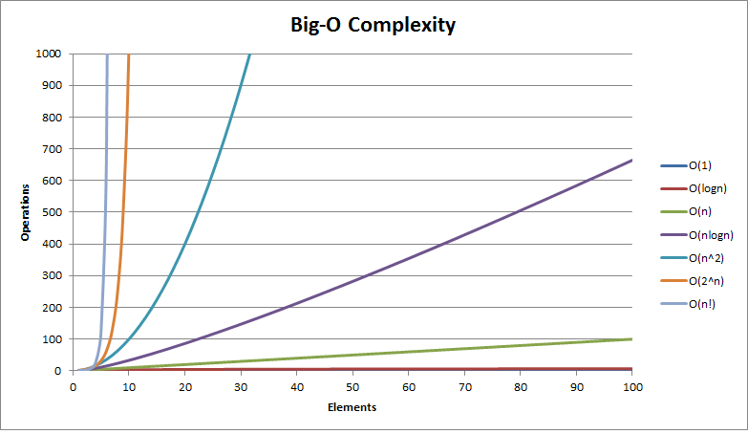
CSC 143 Java
Program Efficiency &
Introduction to Complexity Theory

Slide 2
When does implementation matter?
There are SEVERAL algorithms that solve the SAME problem
→ Need to decide which one to choose
Problem | Algorithms
Sort
Put elements in a certain order
Bucket sort
Bubble sort
Merge sort
Quick sort
Search
Retrieve information stored
within some data structure
Sequential Search
Binary Search
Anagrams
One string is an anagram of another if the second is a rearrangement of the first
Checking Off
Sort and compare
Brute Force
Count and compare
Notes:
https://interactivepython.org/runestone/static/pythonds/AlgorithmAnalysis/AnAnagramDetectionExample.html
An algorithm is step by step instructions to solve given problem

Slide 3
Analysis of Execution Time
public static int indexOf(int[] arr, int val) {
int arrLen = arr.length;
for (int i = 0; i < arrLen; i++)
if (arr[i] == val) return i;
return -1;
}
Skip
In a sequential search of an array:
worst-case:
4n+3 → complexity is linear
best-case:
6 → complexity is constant (independent of input size)
average case:
4n/2 +3 = 2n+3 → complexity is linear
Notes:
Au01: Go through preceding slide and analyze sum after talking about this

Slide 4
Why do you need to evaluate an algorithm?
Find most optimal algorithm for solving given problem, considering various factors and constraints:
Execution time
Execution space (choosing the correct data structure)
Network bandwidth
…
Goal: How fast or slow the particular algorithm performs
Calculate time complexity of the algorithm
Problem: Several factors impact the actual time
Instruction set
CPU
Brand of compiler…
Notes:
Give and
You want to go from city A to City B.Then there are various choices available i.e. by flight,bus or train.So you need to choose among different options depending on your budget and urgency.

Slide 5
Analysis of Execution Time
Idea: Count the number of steps needed to accomplish the algorithm as a function of the problem size (size of data structure)
Example:
Calculate complexity of summing an array of n numbers
Algorithm:
We will scan the array in a for loop, adding 1 number per 1 iteration
Number of steps T(n) = n

Slide 6
Asymptotic behavior
To determine runtime complexity:
Calculate T(n) (number of fundamental steps vs. problem size)
Disregard constants
Look how running time is affected when input size is quite large.
Drop the terms that grow slowly (or do not grow at all) and only keep the ones that grow fast as n becomes larger
Examples:
T(n) = 5n + 42
→ the fastest growing term is n → linear runtime complexity
T(n) = 37n + 3n² + 120
→ the fastest growing term is n² →quadratic runtime complexity
Notes:
$Proof: 3n^{2}+37n+120≤$ $3n^{2}+37n+120n≤3n^{2}+157n^{2}$ $≤160n^{2}$

Slide 7
Cost of operations: Constant Time Ops
Each take one foundamental time “step”:
Simple variable declaration/initialization (double sum = 0.0;)
Assignment of numeric or reference values (var = value;)
Arithmetic operation (+, -, *, /, %)
Array subscripting (a[index])
Simple conditional tests (x < y, p != null)
Operator new (NOT including constructor cost)
Note: new takes significantly longer than simple arithmetic or assignment, but its cost is independent of the problem size
CAUTION: watch out for method calls or constructor invocations that look simple, but might be expensive

Slide 8
Costs of Statements
Sequential: S1; S2; … Sn
→sum the costs of S1 + S2 + … + Sn
Conditional: how long it might take to execute the code
if (condition) {S1;}
else {S2;}
→ max cost ( S1, S2) + cost of evaluating the condition
Loop:
Calculate cost of each iteration
Calculate number of iterations
→ Total cost is the product of these

Slide 9
Costs of Statements Method Calls
Cost for f(a, b, c) is
Cost of actually calling the method (constant overhead)
+ cost of evaluating the arguments
+ cost of parameter passing (normally constant time in Java for both numeric and reference values)
+ cost of executing the method body

Slide 10
Analysis of Execution Time
public static int indexOf(int[] arr, int val) {
int arrLen = arr.length;
for (int i = 0; i < arrLen; i++)
if (arr[i] == val) return i;
return -1;
}
Notes:
Au01: Go through preceding slide and analyze sum after talking about this

Slide 11
Analysis of Execution Time
public static int indexOf(int[] arr, int val) {
int arrLen = arr.length;
for (int i = 0; i < arrLen; i++) if (arr[i] == val) return i;
return -1;
}
The fundamental instructions:
Assigning a value to a variable: 1 ‘step’ (int arrLen=arr.length)
+1 ‘step’ (int i = 0)
Return statement : +1 ‘step’ (either i or -1)
for loop : ?
Accessing array: 1 ‘step’ (arr[i])
Comparing two values: + 1 ‘step’ (arr[i] == val)
Inside () of for: + 2 ‘steps’ (i < arrLen; i++)
Notes:
Au01: Go through preceding slide and analyze sum after talking about this

Slide 12
Different types of complexities
The worst-case runtime complexity is
the maximum number of steps taken on any instance of size n.
The best-case runtime complexity is
the minimum number of steps taken on any instance of size n.
The average case runtime complexity is
an average number of steps taken on any instance of size n.

Slide 13
Analysis of Execution Time
public static int indexOf(int[] arr, int val) {
int n = arr.length;
for (int i = 0; i < n; i++)
if (arr[i] == val) return i;
return -1;
}
In a sequential search of an array:
worst-case: 4n+3
→ complexity is linear
best-case: 6
→ complexity is constant (independent of input size)
average case: 4n/2 +3 = 2n+3 → complexity is linear
T(n)=
Outside for loop: 3 steps
+
(Inside for loop: 4 steps
*
Number of iterations: ?)
Notes:
Au01: Go through preceding slide and analyze sum after talking about this

Slide 14
What about nested loop?
int m=0; //executed in constant time c1
// Outer loop - executed n times
for (int i = 0; i < n; i++)
// Inner loop - be executed n times
for(int j = 0; j < n; j++)
sum += i * j; //executed in constant time c2
Runtime complexity is quadratic
Rule of thumb: Simple programs can be analyzed by counting the nested loops of the program:
A single loop over n items → linear complexity
A loop within a loop → quadratic complexity
A loop within a loop within a loop yields → cubic complexity

Slide 15
What if number of iterations of one loop depends on the counter of the other?
int i,k,sum = 0;
for ( i = 0; i < n; i++ )
for ( j = 0; j < i; j++ )
sum +=i * j;
Analyze inner and outer loops together :
0 + 1 + 2 + … + (n-1) = n(n-1)/2
→ Quadratic complexity

Slide 16
“big-O”
exponential
quadratic
nlogn
linear
constant
Notes:
http://stackoverflow.com/questions/487258/what-is-a-plain-english-explanation-of-big-o-notation

Slide 17
Complexity Classes
Several common complexity classes (problem size n)
Constant time: O(k) or O(1)
Logarithmic time: O(log n) [Base doesn’t matter. Why?]
Linear time: O(n)
“n log n” time: O(n log n)
Quadratic time: O(n²)
Cubic time: O(n³)
Exponential time: O(k^{n})
O(n^{k}) is often called polynomial time

Slide 18
When Complexity is Important…
Problem | Algorithms
Sort
Put elements
in a certain order
Bucket sort
Bubble sort
Merge sort
Quick sort
Search
Retrieve information stored
within some data structure
Sequential Search
Binary Search
Anagrams
One string is an anagram of another if the second is a rearrangement of the first
Checking Off
Sort and compare
Brute Force
Count and compare
Notes:
https://interactivepython.org/runestone/static/pythonds/AlgorithmAnalysis/AnAnagramDetectionExample.html

Slide 19
Sequential (Linear) Search
public int indexOf(Object o) {
if (o==null){
for (int i = 0; i < size; i++) {
if (elementData[i]==null)
return i;
}
}
else{
for (int i = 0; i < size; i++) {
if (elementData[i].equals(o)) return i;
}
}
return -1;
}

Slide 20
Sequential search
Locates a target value in an array/list by examining each element from start to finish.
“Worst-case” scenario:
O(n)
Example: Searching the array below for the value 42:
Notice that the array is sorted. Could we take advantage of this?
index | 0 | 1 | 2 | 3 | 4 | 5 | 6 | 7 | 8 | 9 | 10 | 11 | 12 | 13 | 14 | 15 | 16
value | -4 | 2 | 7 | 10 | 15 | 20 | 22 | 25 | 30 | 36 | 42 | 50 | 56 | 68 | 85 | 92 | 103
i

Slide 21
Binary search
Locates a target value in a sorted array/list
Algorithm: Examine the middle element of the array.
If it is too big, eliminate the right half of the array and repeat.
If it is too small, eliminate the left half of the array and repeat.
Else it is the value we are searching for, so stop
Example: Searching the array below for the value 42:
How many elements will it need to examine?
index | 0 | 1 | 2 | 3 | 4 | 5 | 6 | 7 | 8 | 9 | 10 | 11 | 12 | 13 | 14 | 15 | 16
value | -4 | 2 | 7 | 10 | 15 | 20 | 22 | 25 | 30 | 36 | 42 | 50 | 56 | 68 | 85 | 92 | 103
min
mid
max

Slide 22
What does this function do and what is its complexity ?
int mystery (int x) {
if (x <= 0) throw new IllegalArgumentException();
if (x == 1) return 0;
return 1 + mystery (x / 2);
}
Try it with arguments of 4, 8 and 2.

Slide 23
Binary search runtime
For an array of size N, it eliminates ½ until 1 element remains: N, N/2, N/4, N/8, ..., 4, 2, 1
How many divisions does it take?
Think of it from the other direction:
How many times do I have to multiply by 2 to reach N?
1, 2, 4, 8, ..., N/4, N/2, N
Call this number of multiplications "x".
2^{x} = N
x = log₂ N
→ Binary search has logarithmic complexity - O(logN)

Slide 24
Picture the Execution
All paths from the size N case to a size 0 case are the same length: 1+log₂N
Any given run of binary search will follow only one path from the root to some leaf
N
N/2
N/2
N/4
N/4
N/4
N/4
...
...
1
1
1
1
...
0
0
0
0
0
0
0
0

Slide 25
Exercise – Implement recursively
// Returns the index of an occurrence of the given value in
// the given array, or a negative number if not found.
// Precondition: elements of a are in sorted order
public static int binarySearch(int[] a, int target) {
return binarySearch(a, target, 0, a.length - 1);
}
// Recursive helper to implement search behavior.
private static int binarySearch(int[] a, int target,
int min, int max) {
if (min > max) return -1; // target not found
int mid = (min + max) / 2;
if (a[mid] < target) // too small; go right
return binarySearch(a, target, mid + 1, max);
else if (a[mid] > target) // too large; go left
return binarySearch(a, target, min, mid - 1);
else return mid; // target found; a[mid] == target
}

Slide 26
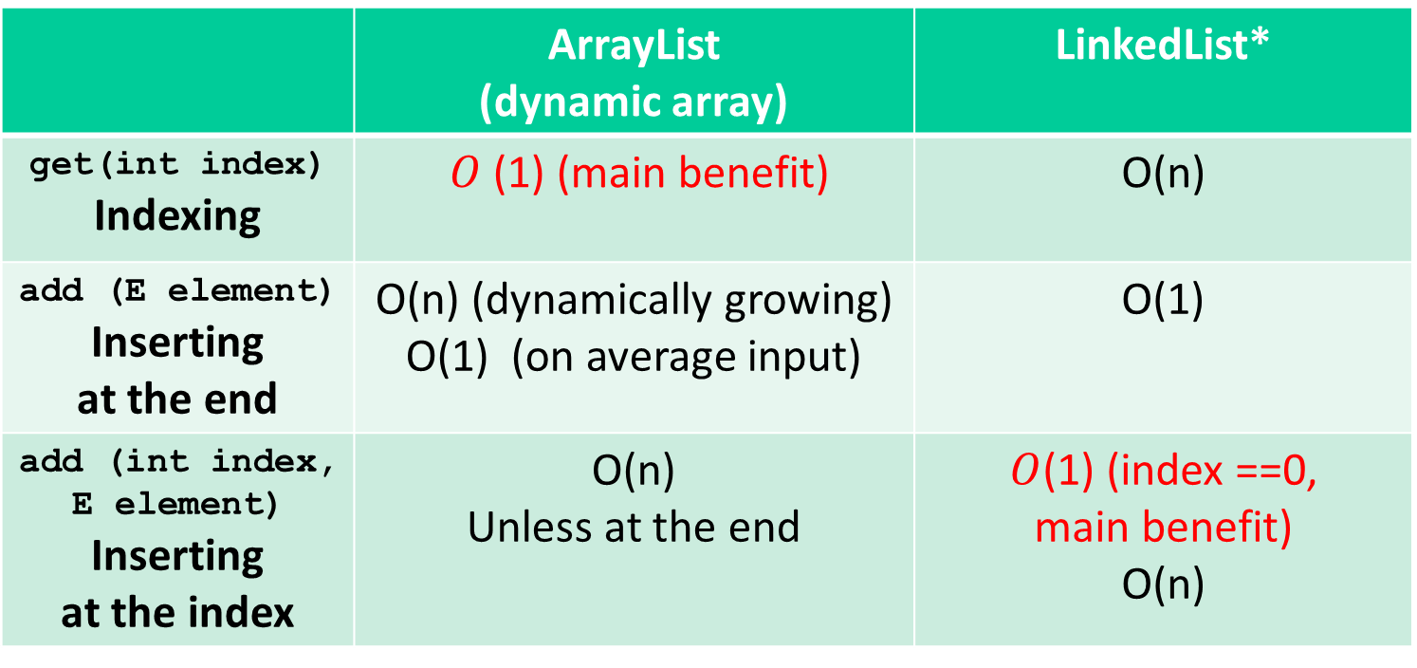
ArrayList vs. LinkedList* in Java
 | ArrayList (dynamic array) | LinkedList*
get(int index) Indexing | $O$(1) (main benefit) | O(n)
add (E element) Inserting at the end | O(n) (dynamically growing) O(1) (on average input) | O(1)
add (int index, E element) Inserting at the index | O(n) Unless at the end | $O$(1) (index ==0, main benefit) O(n)
* with head, tail, and size

Slide 27
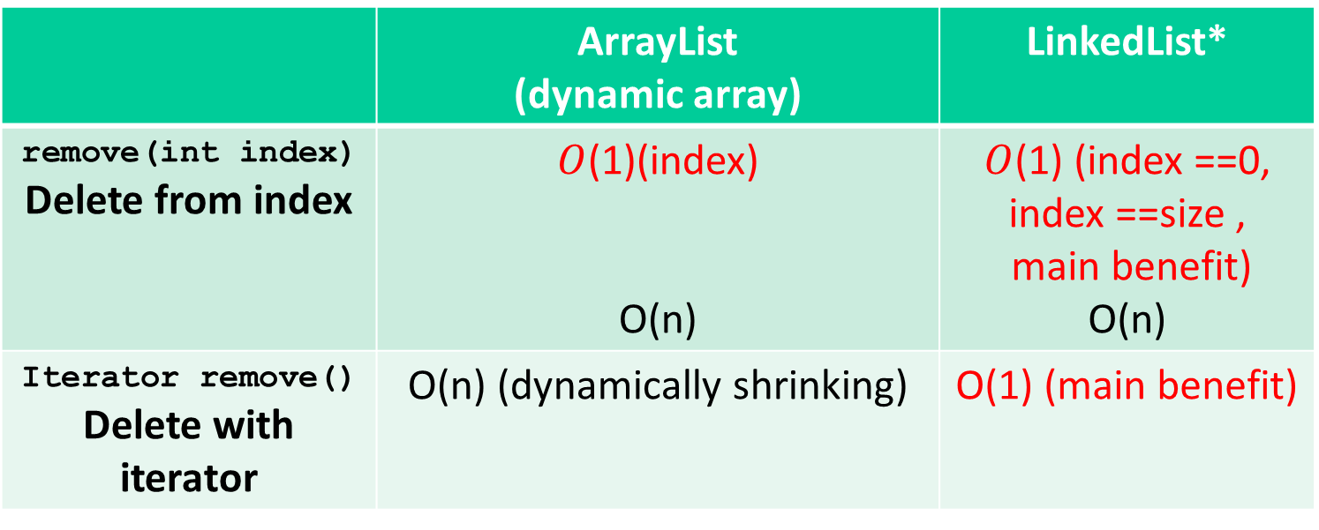
ArrayList vs. LinkedList* in Java
 | ArrayList (dynamic array) | LinkedList*
remove(int index) Delete from index | $O$(1)(index) O(n) | $O$(1) (index ==0, index ==size , main benefit) O(n)
Iterator remove() Delete with iterator | O(n) (dynamically shrinking) | O(1) (main benefit)
* with head, tail, and size

Slide 28
What is the complexity of the following code?
List list = new List();
...
for (int i = 0; i < list.size(); i++) {
int value = list.get(i);
if (value % 2 == 1) {
list.remove(i);
}
}

Slide 29
What is the complexity of the following code?
List<Integer> list = new LinkedList<Integer>();
for (int i = 0; i < list.size(); i++) {
int value = list.get(i);
if (value % 2 == 1) {
list.remove(i);
}
}
public int get(int index) {
ListNode current = nodeAt(index);
return current.data;
}
public void remove(int index) {
if (index == 0) front = front.next;
else {
ListNode current = nodeAt(index – 1);
current.next = current.next.next;
}
}
ListNode current = front;
for (int i = 0; i < index; i++)
current = current.next;
return current;

Slide 30
The get method
// Returns value in list at given index.
// Precondition: 0 <= index < size()
public int get(int index) {
//reach the index
ListNode current = front;
for (int i = 0; i < index; i++) {
current = current.next;
}
return current.data;
}
CheckElement
should be added
Replace with
nodeAt(index)
Notes:
CheckElementIndex → IndexOutOfBoundsException

Slide 31
remove
// Removes value at given index from list.
// Precondition: 0 <= index < size()
public void remove(int index) {
if (index == 0) {
// special case: removing first element
front = front.next;
} else {
// removing from elsewhere in the list
ListNode current = front;
for (int i = 0; i < index - 1; i++) {
current = current.next;
}
current.next = current.next.next;
}
}
CheckElement
should be added
Replace with
nodeAt(index-1)

Slide 32
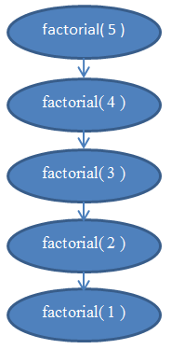
Factorial
public static int factorial(int n) {
if ( n < 0) throw new IllegalArgumentException();
if ( n == 1 || n == 0)
return 1;
return n * factorial(n-1);
}

