Slide 1
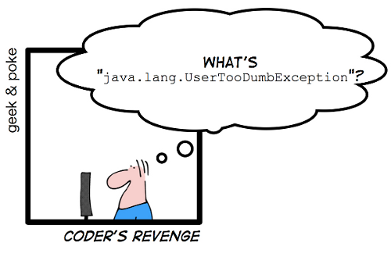
CSE 143 Java
Exceptions

Slide 2
Verifying Validity of Input Parameters
A non-private method should always perform parameter validation as its caller is out of scope of its implementation
http://docs.oracle.com/javase/7/docs/technotes/guides/language/assert.html
/** @param rate refresh rate, in frames per second.
* @throws IllegalArgumentException if rate <= 0 or
* rate > MAX_REFRESH_RATE. */
public void setRefreshRate(int rate) {
// Enforce specified precondition in public method
if (rate <= 0 || rate > MAX_REFRESH_RATE) throw new
IllegalArgumentException("Illegal rate: " + rate);
setRefreshInterval(1000/rate);
}
Preconditions on public methods are enforced by explicit checks that throw particular, specified exceptions

Slide 3
Exception Handling
Exceptions: represent unusual events (as well as errors)
  Finite table is full; cannot add new element
  Attempt to open a file failed
Problems:
  the method that detects the error does not know how to handle it (and probably should not)
  the client code could handle the error, but is not in a position to detect it
Solution: method detecting an error throws an exception; client code catches and handles it

Slide 4
Exceptions as Part of Method Specifications
What should a client code method do with exception?
Either must handle it
    void readSomeStuff( ) {
    try {
    readIt( ); // potentially throws an Exception
    }
    catch (Exception e) {
    handle
    }
Or declare that it can potentially throw it
    void readSomeStuff( ) throws Exception {
    readIt( );
    }

Slide 5
try-catch
try {
somethingThatMightBlowUp( );
} catch (Exception e) {
recovery code – e, the exception object, is a “parameter”
}
  Execute try block
  If an exception is thrown, catch block can either process the exception, re-throw it, or throw another exception
  Thrown exceptions terminate throwing method and all methods that called it, until reaching a method that catches the exception (has a catch block whose type matches the exception)
  If there is no try/catch → terminate the thread (possibly the program)

Slide 6
try-catch
Can have several catch blocks
    try {attemptToReadFile( );}
    catch (FileNotFoundException e) {…}
    catch (IOException e) {…}
    catch (Exception e) { …}
Semantics: try to match exception parameters in order until one matches
Need to go from more specific to more general (why?)
If no match – exception propagates (gets thrown) to calling method
In Java SE 7 and later, a single catch block can handle more than one type of exception :
catch (FileNotFoundException | IOException | Exception e) {…}
http://www.oracle.com/technetwork/articles/java/java7exceptions-486908.html

Slide 7
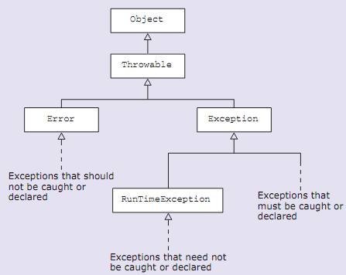
Throwable/Exception Hierarchy
Checked
Unchecked

Slide 8
Checked vs Unchecked Exceptions
Checked: are exceptions that are checked at the compile time
Represent invalid conditions in areas outside the immediate control of the program (invalid user input, database problems, network outages, absent files)
Are subclasses of Exception
Method must establish a policy for all checked exceptions thrown by its implementation
  either handle them somehow
  → catch all checked exceptions it might encounter (try-catch)
  or pass the checked exceptions further up the stack
  → declare that it might throw them (using throws keyword)

Slide 9
Checked vs Unchecked Exceptions
Unchecked: are not checked at the compile time.
Represent defects in the program (bugs)
Reflect errors in program's logic from which it is not possible to recover at a run time
Often invalid arguments passed to a non-private method.
Are subclasses of RuntimeException, and are usually implemented using IllegalArgumentException, NullPointerException, or IllegalStateException
Method is NOT obliged to establish a policy for the unchecked exceptions thrown by its implementation
(almost always does not do so)
Notes:
In C++, all exceptions are unchecked, so it is not forced by the compiler to either handle or specify the exception. It is up to the programmers to be civilized, and specify or catch the exceptions.
In Java exceptions under Error and RuntimeException classes are unchecked exceptions, everything else under throwable is checked.

Slide 10
Checked vs Unchecked Exceptions
No need to declare anything about unchecked exceptions
Include an @throws in the JavaDocs for ones specifically thrown
RuntimeException (unchecked) is itself a subclass of Exception (checked).
Why to have both types?
http://docs.oracle.com/javase/tutorial/essential/exceptions/runtime.html
http://www.javamadesoeasy.com/2015/05/exceptions-top-60-interview-questions_16.html
Notes:
More details on http://www.javamadesoeasy.com/2015/05/exceptions-top-60-interview-questions_16.html

Slide 11
Writing your own exception
/**
Represents an exception thrown when an invalid value is given for radius
*/
public class InvalidRadiusException extends RuntimeException { /**
* {@inheritDoc}
*/
public InvalidRadiusException(String message) { super(message);
}
}
Is this checked or unchecked exception?

Slide 12
What can we do with InvalidRadiusException?
public class Circle extends AbstractShape {
/**
* Given a pin and a radius greater than 0, creates a circle
* @param pin the location of this circle's pin
* @param radius this circle's radius. The radius must be greater than 0
* @throws InvalidRadiusException if the radius is negative or zero
public Circle(Posn pin, Integer radius) {
super(pin);
if (radius <= 0) {
throw new InvalidRadiusException("Radius must be > 0, given: " + radius);
}
this.radius = radius;
} // elided code
}

Slide 13
Do we need to handle it?
Since InvalidRadiusException is unchecked (why?), we may or may not handle it
Example of how to handle:
Somewhere inside VERY important client code:
try {
Circle myCircle = new Circle(new Pin(0,0), -2);
}
catch (InvalidRadiusException invalidRadius) { ShowErrorMEssage errorMessage = new ShowErrorMessage
( "We detected an incorrect value " + "for myCircle. “ + "Please provide a positive number.");
new Window(errorMessage).exit();
}
Always be VERY descriptive in your error message

